Slide 1
Pre-primary Education to Ultra Poor From access to quality
Muzaffar uddin
BRAC - Pakistan

Slide 2
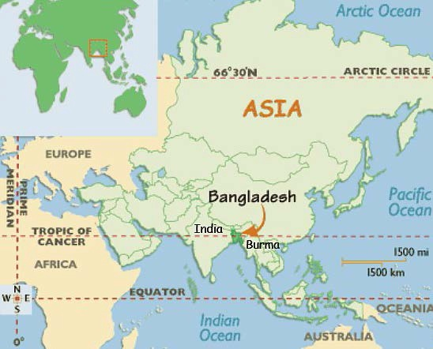

BANGLADESH
Total area : 147,570 sq.kilometres
Population : about 160 million
Population growth rate : 1.37%
Density per sq. Kilometre: 1205
Literacy rate: 59.82%
Per capita income : US$ 1044
Urban population :27 % ,
Rural population : 73%

Slide 3
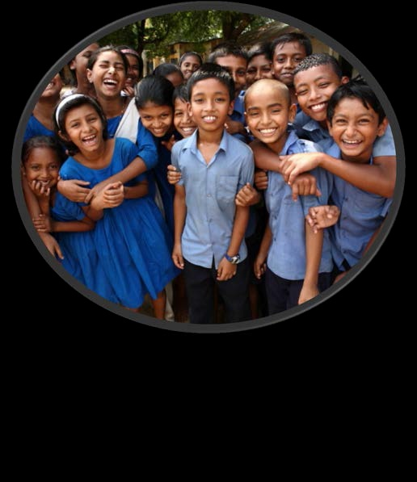
Bangladesh
Bangladesh has met some important
targets of MDGs including reducing poverty gap
ratio, attaining gender parity at primary and secondary education, reduction in
under-five mortality rate
Bangladesh identified as one of the
'Highlighted 18' countries that made rapid
headway in human development according
to the HDR 2013

Slide 4
BRAC
Established in Bangladesh 1972
Goal: poverty alleviation & empowerment of poor
The largest NGO by some measures
Total staff: 120,000+
Total budget for 2012: US$650m
Works globally since 2002
Largest secular education system

Slide 5
Pre-Primary School
Introduced in 1997, pre-primary education is a critical strategic intervention for promoting the quality of primary schooling especially for children with illiterate parents.
Pre-primary education helps children transition from home to formal schooling.
The main objective of the programme is to prepare underprivileged children for entry to mainstream primary school .
Besides education, children with special needs are also provided with medical support, and necessary assistive devices

Slide 6
Key Features of Pre-Primary School
Centre based approach with one teacher for 25-30 children
Girls aged five and more
Sixty percent female students
No tuition fee
Flexible class hours
2.5 to 3 hours of schooling per day
One local female teacher with 10 years of schooling experience
School located on catchment of mainstream primary school
Fun and activity based pre-school education.
Mother forums with a mandatory one day per month session.
Ensure community participation thought SMCs.
Tracking former pre-primary students during their study in the mainstream primary school.
Training of government and private school teachers.

Slide 7
Gross and net enrolment ratios at pre-primary level
Source: Education Watch studies

Slide 8
Net enrolment rate (%) at primary level
Source: Education Watch studies

Slide 9
Dropout rate at primary level
2005-2012
Source: Directorate of Primary Education, 2013

Slide 10
Scale of BRAC Primary Education Programme
Type | Number | Students
Pre-primary | 12,450 | 359,680
Primary | 22,546 | 674,379
Cost-recovery | 5,007 | 151,142
Total | 40,003 | 1,185,201

Slide 12
Item-wise Expenditure in Govt. Primary Schools and BRAC Primary Schools (2004/2005)
Sl. | Particulars |  | Govt. Primary schools (% of total) | BRAC Primary Schools (% of total)
1 | Salary |  | 67.0 | 46.1
2 | Non salary |  | 22.2 | 47.7
3 | Capital |  | 9.8 | -
4 | Others |  | 0.9 | 6.2
 | Total |  | 100 | 100
Sources: Education Bangladesh by Manzoor Ahmed (Page 251)

Slide 13
BRAC Schools outside Bangladesh
Country | Number of school | Total students | Total male students | Total female students
Pakistan | 955 | 24,000 | 7,200 | 16,800
Afghanistan | 2,334 | 72,741 | 6,980 | 65,761
Philippines | 1,010 | 31,522 | 16,261 | 15,261
South Sudan | 300 | 9,000 | 3,430 | 5,570
Sierra Leone | 250 | 7,500 | - | 7,500

Slide 14
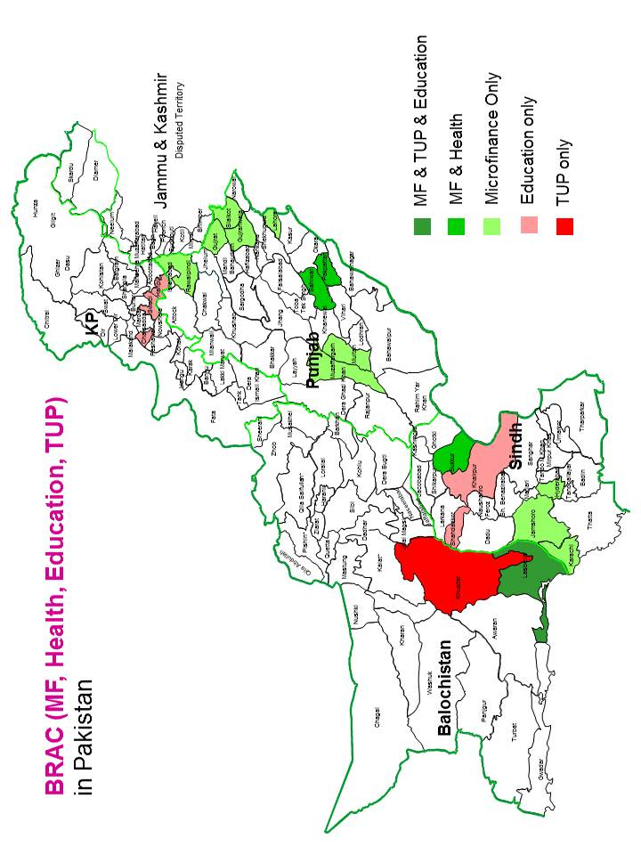
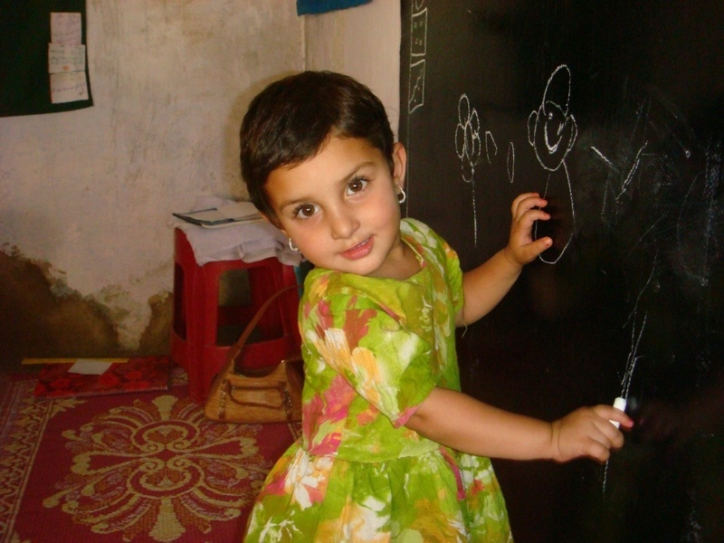
BRAC ECE Project in Three Districts of KPK
BRAC
Pakistan

Slide 15
BRAC Pre-School Experience in Pakistan
Piloted of 255 BRAC pre-primary schools in three district of KP enrolling 7600 children of age 3 to 5 years.
Trained 255 teachers in BRAC schools
Trained 400 government primary schools teachers.
Through 255 mothers’ forums more than 7000 mothers were sensitised and training in basics of early education.

Slide 16
BRAC Pre-School Experience in Pakistan
At least 92% (boys and girls) have been mainstreamed in either of three kinds of institutions, while 8% have not been mainstreamed due to multiple reasons.
Out of the passed out students, 51% are enrolled in government primary schools, 39% are in private schools and 2% in Madrassas.
Enrolling boys in private school is high; 49% as compare to 32% girls. In contrast, girls (58%) were found to be enrolled in government schools as compared to 40% boys.
Source: Mid-term evaluation report

Slide 17
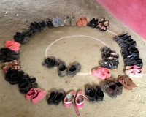

Slide 18
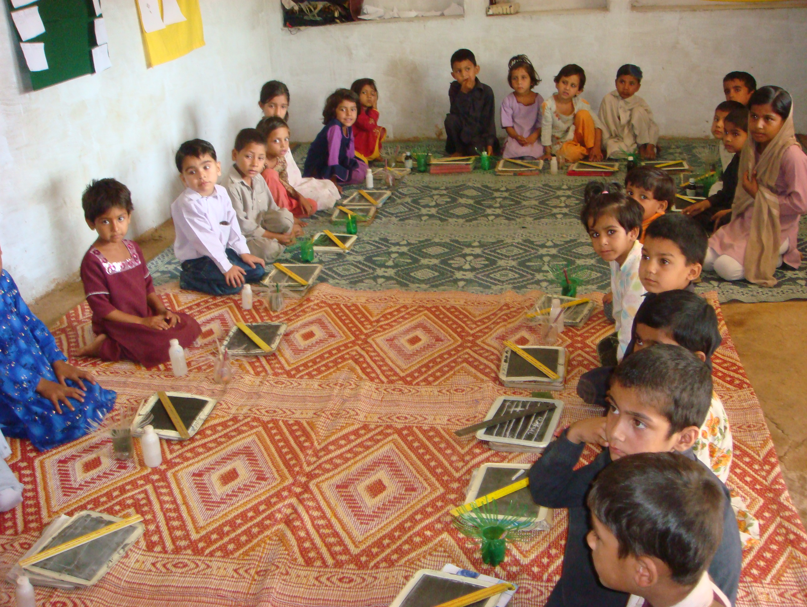

Slide 19
